Slide 1
Soldering iron
Kobe jacobs 1EAI

Slide 2
Soldering station mini
A compact alternative to the conventional soldering station, equipped with features to successfully complete any project.
“Portable and user-friendly. compact and reliable.”

Slide 3

Process
Altium: Learn and use Altium:
Design schematics
Design pcb
Create files for manufacturing of pcb
JLC PCB: Order pcb
Order components: Order components using BOM file
Fusion 360: Design case

Slide 4
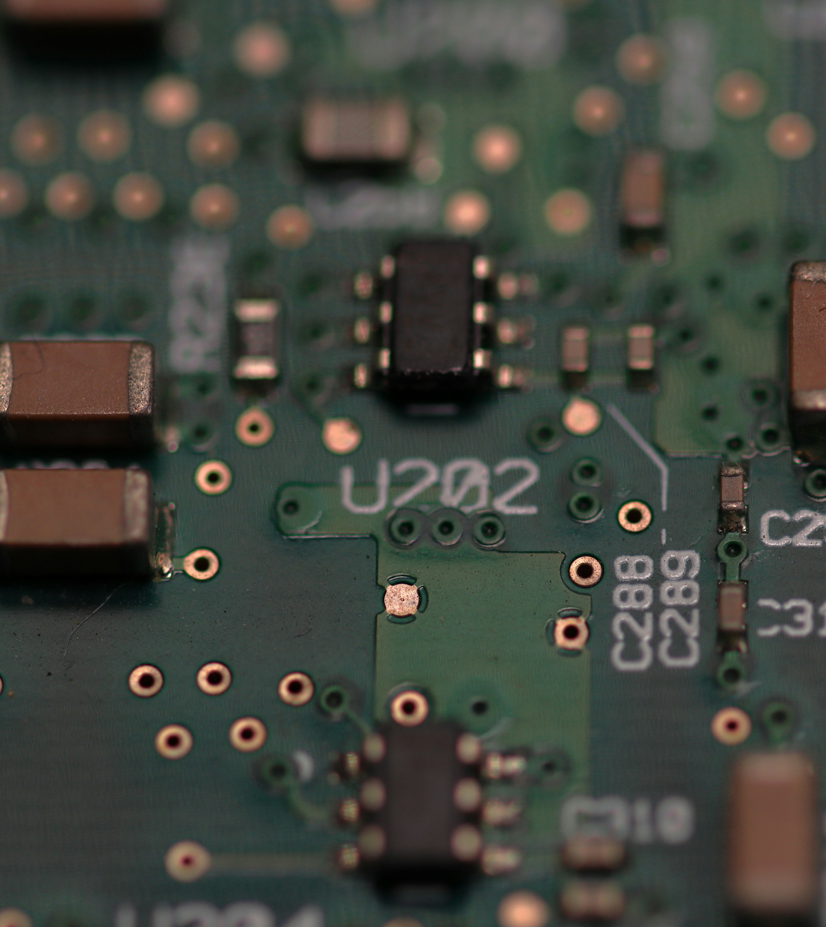
Components
Low cost, readily available components, and a simple assembly process.

Slide 5
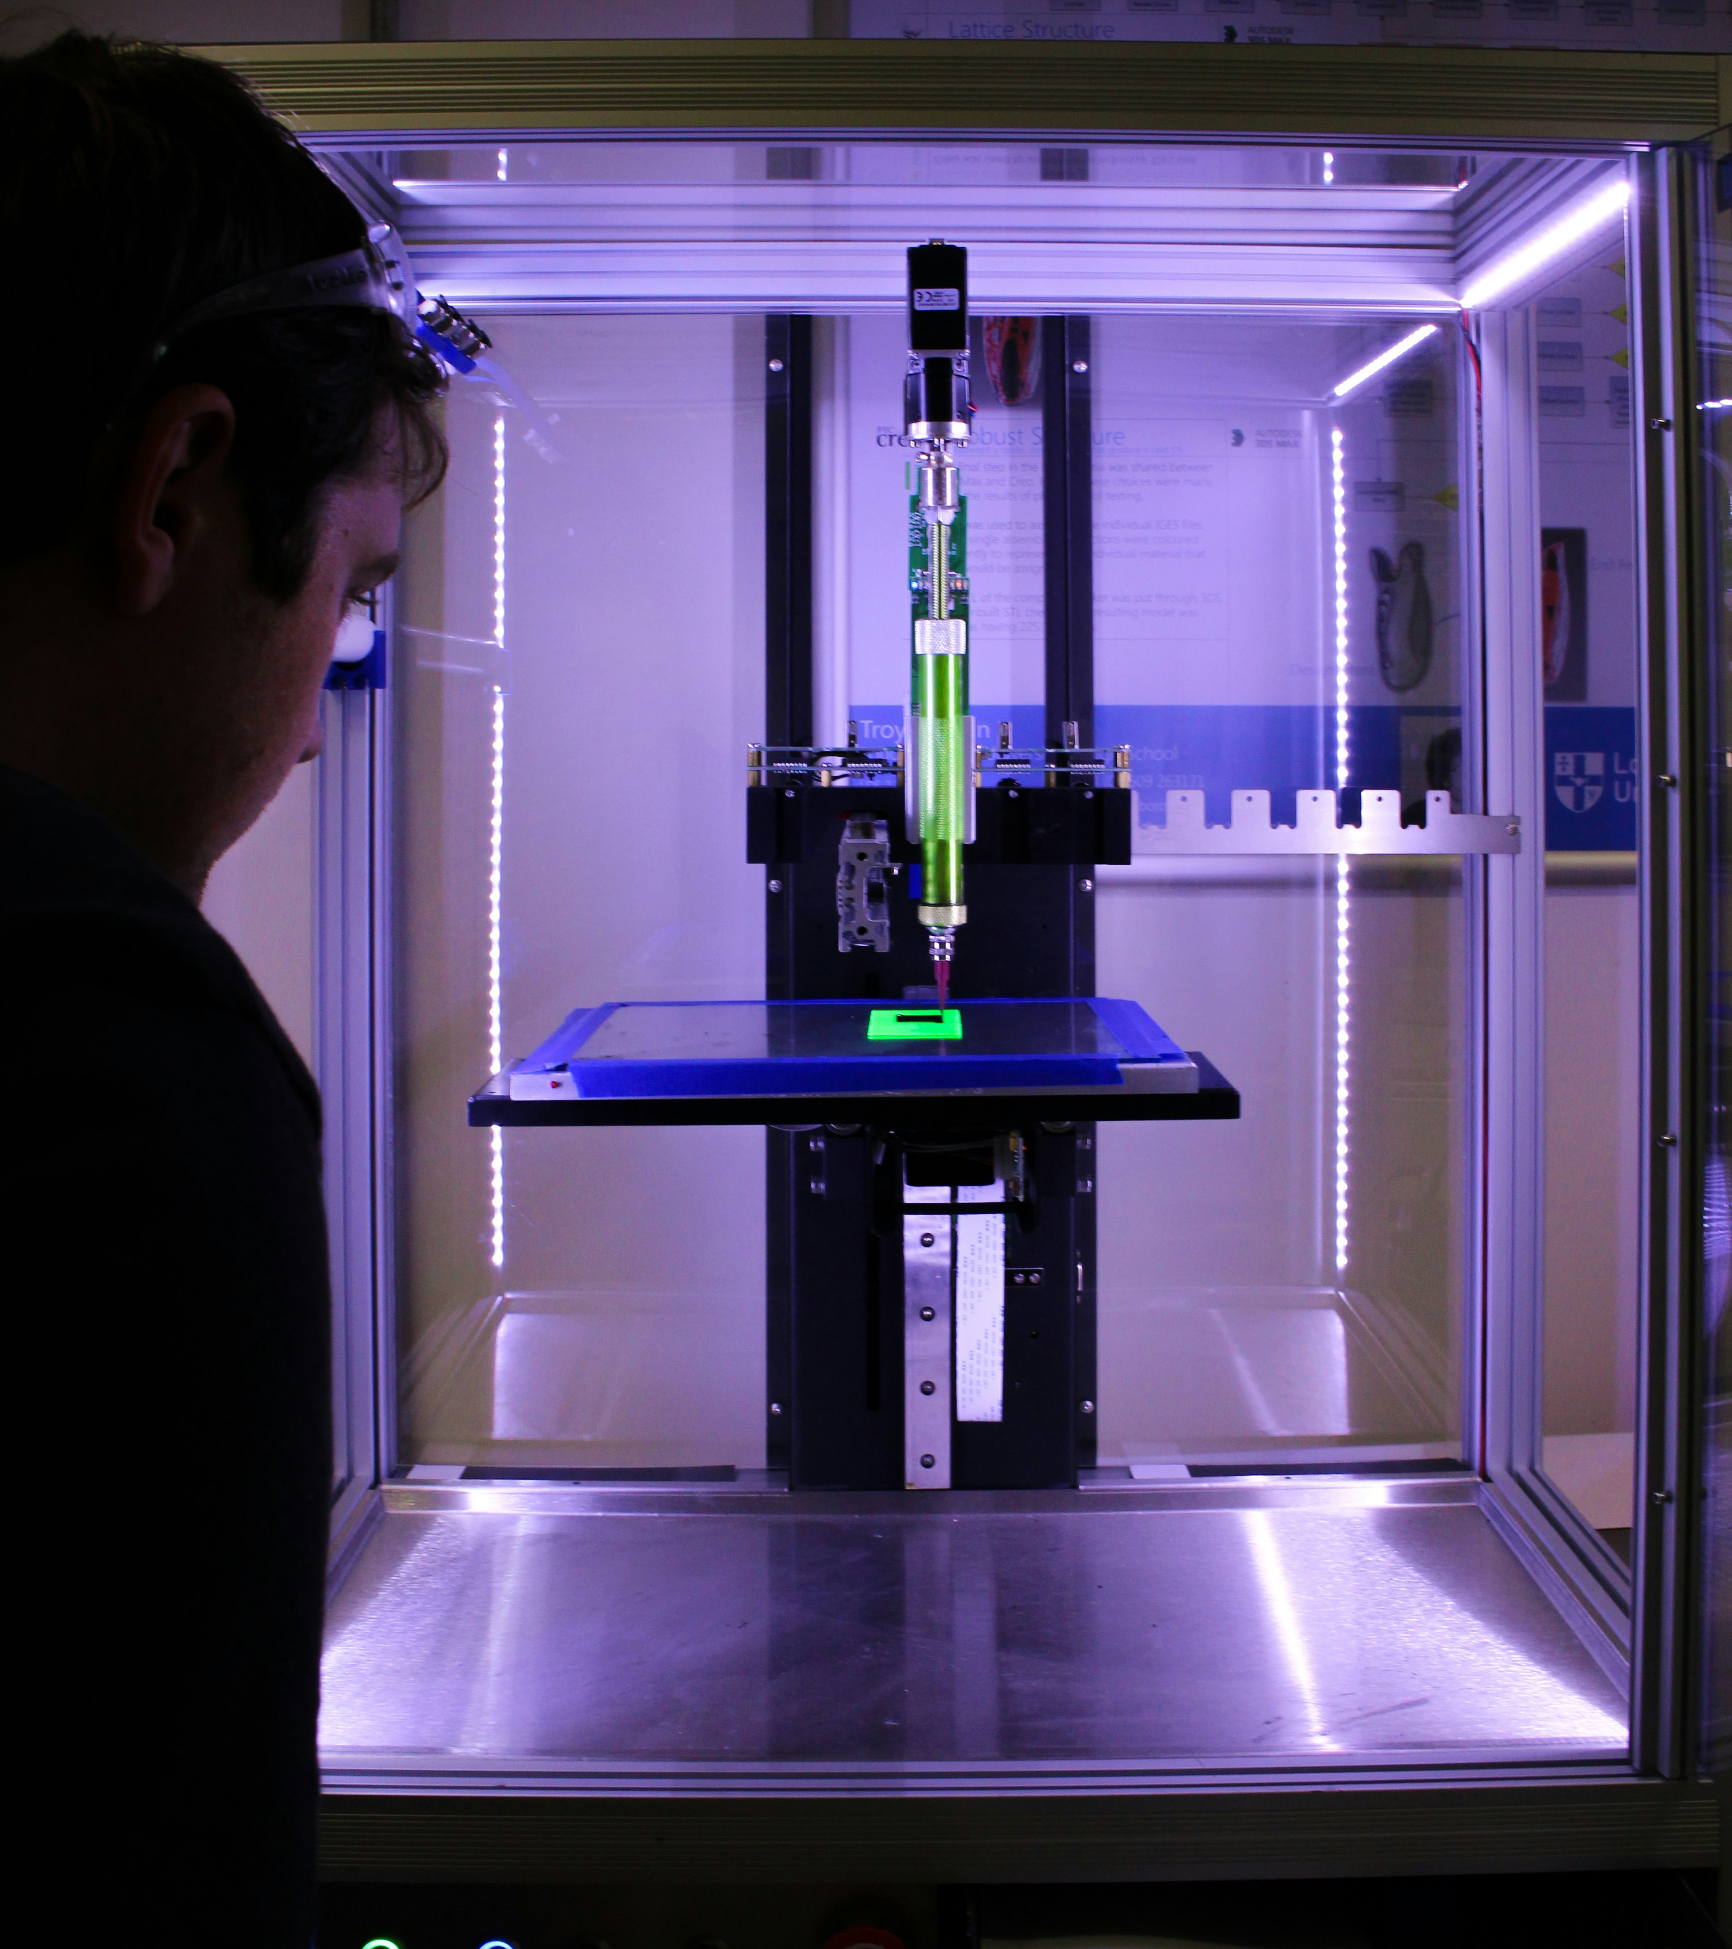
Case design
A simplistic yet reliable case, easy to assemble and portable.

Slide 6
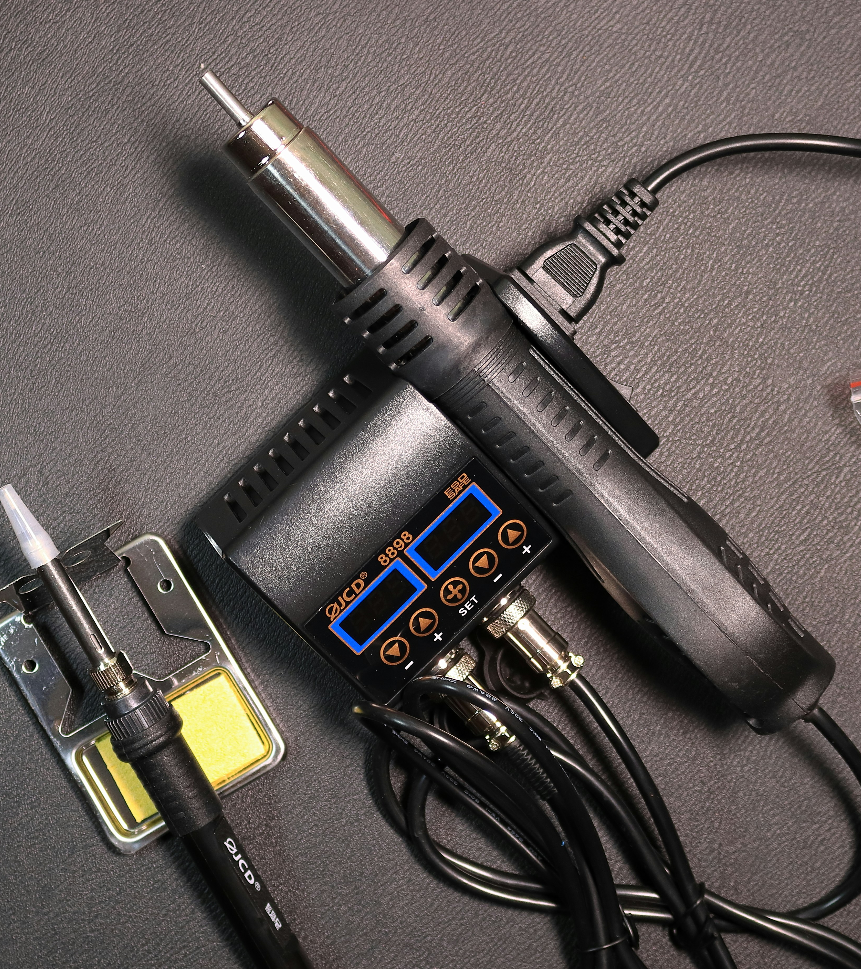
Product benefits
Compact, easy to make, user-friendly, and simply convenient.

Slide 7

Thank you
Kobe Jacobs
1EAI

